Slide 1
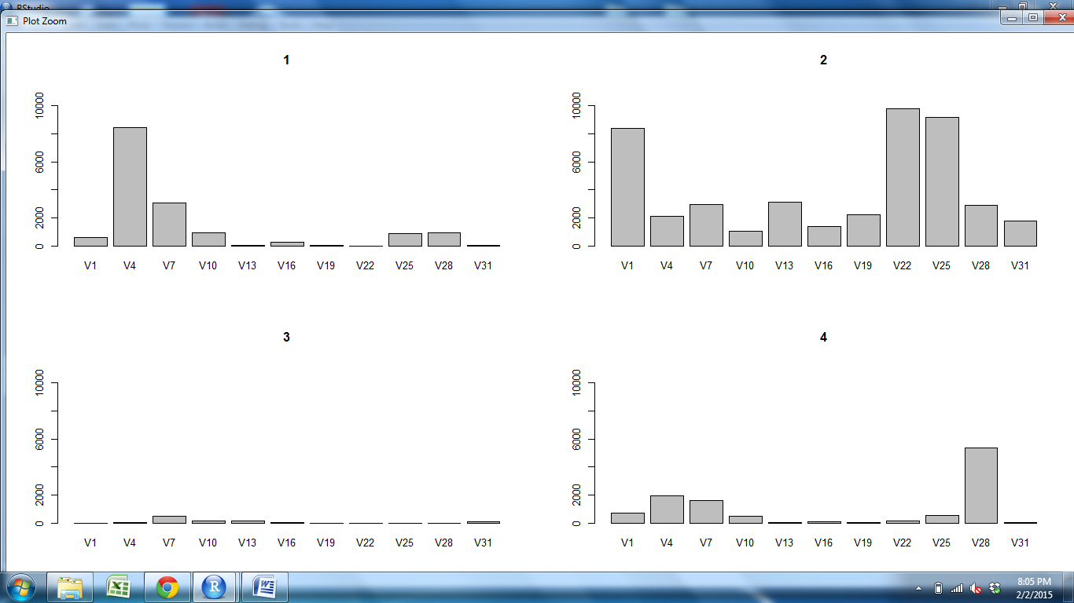
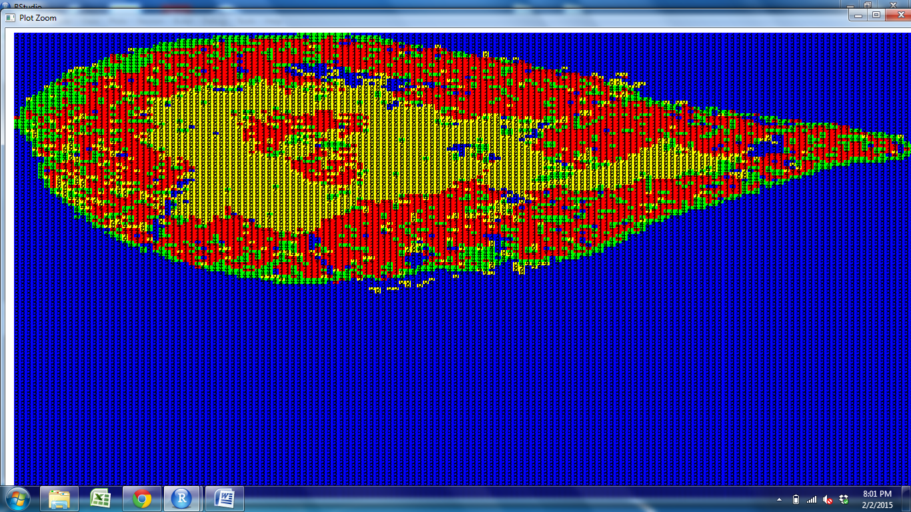
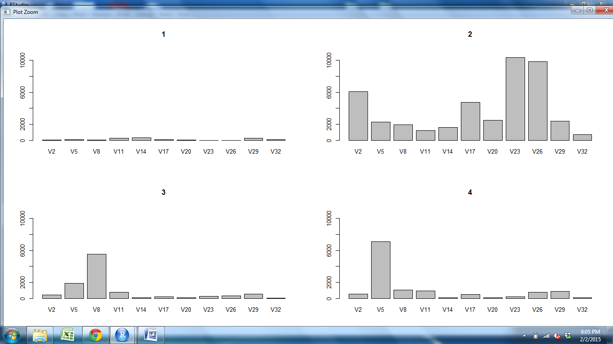
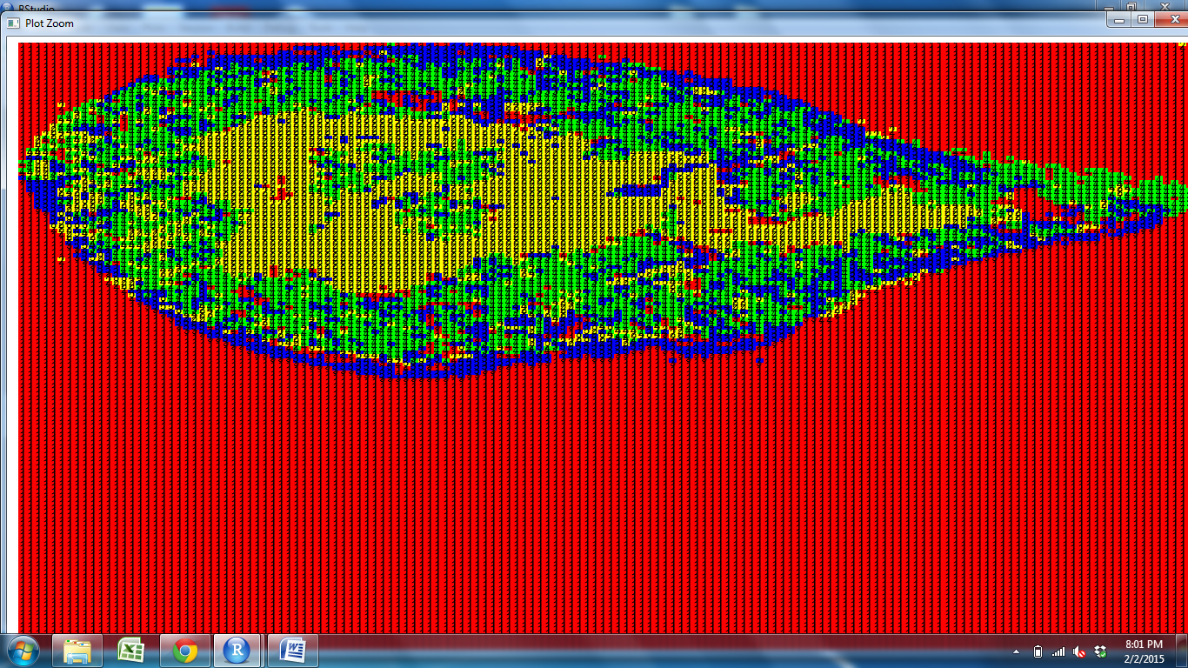
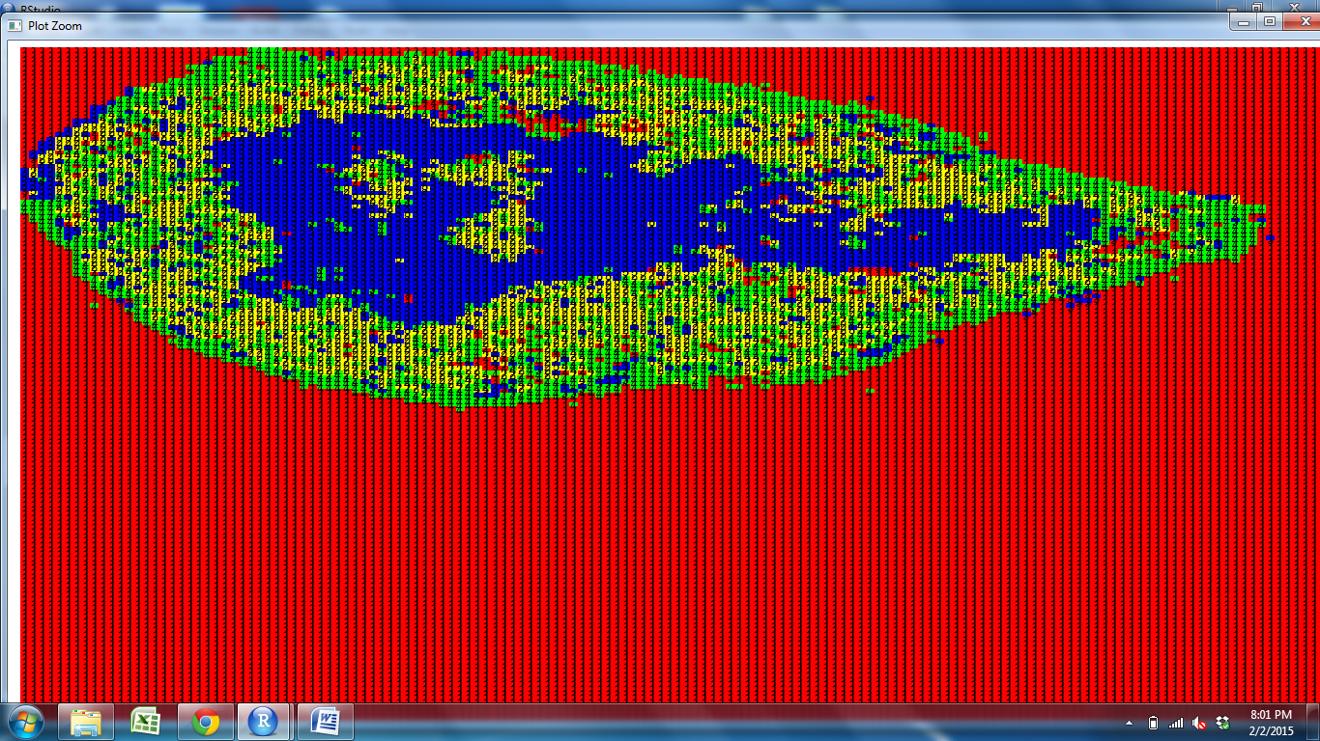
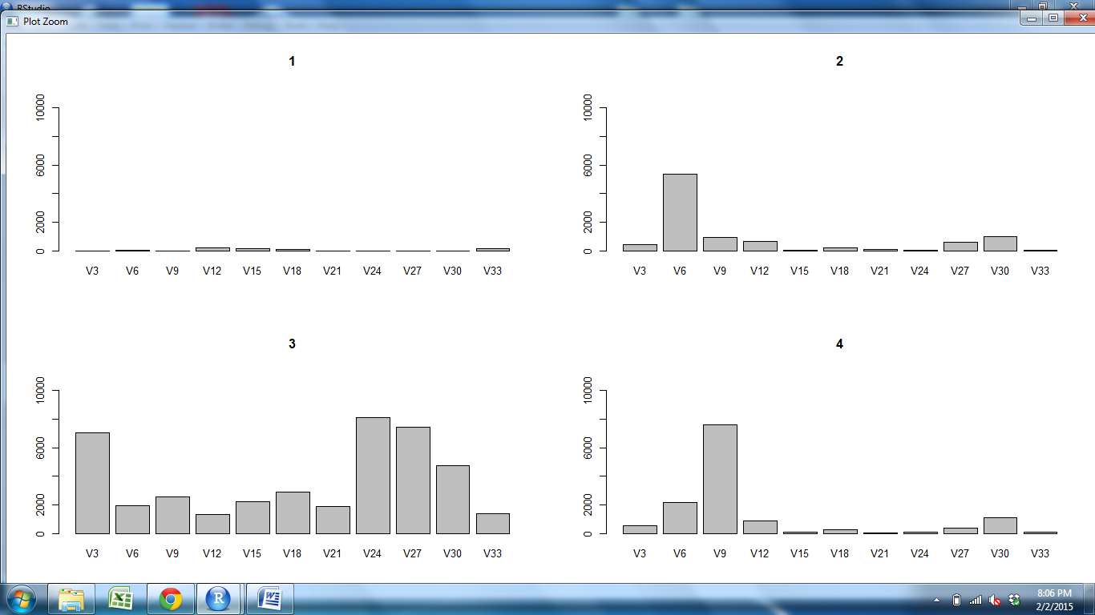
CD11c CD205 CD25 CD31 Claud34 Claud5 Foxp3 K14 K5 PDGFRb UEA1

Slide 2
CD11c CD205 CD25 CD31 Claud34 Claud5 Foxp3 K14 K5 PDGFRb UEA1

Slide 3
CD11c CD205 CD25 CD31 Claud34 Claud5 Foxp3 K14 K5 PDGFRb UEA1

Slide 4
CD11c CD205 CD25 CD31 Claud34 Claud5 Foxp3 K14 K5 PDGFRb UEA1

Slide 5
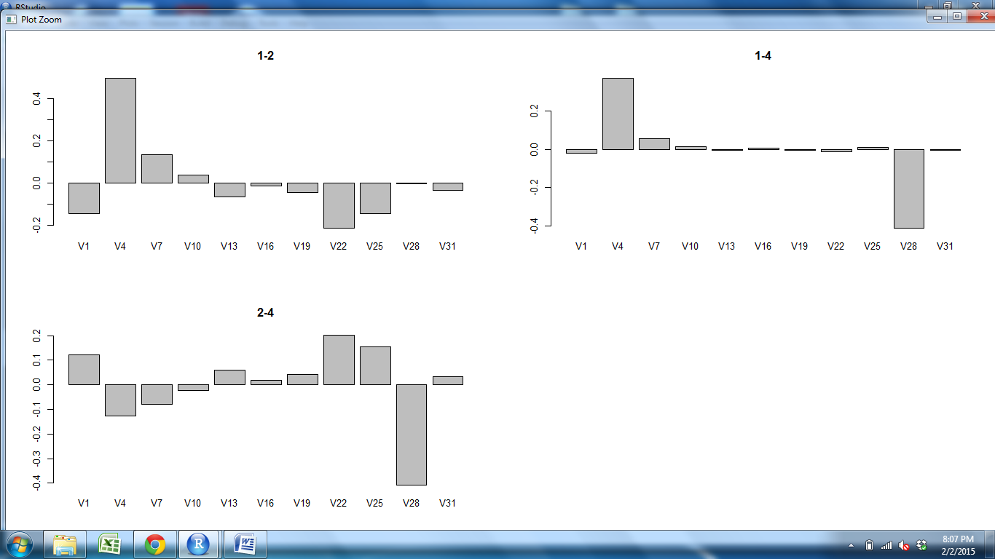
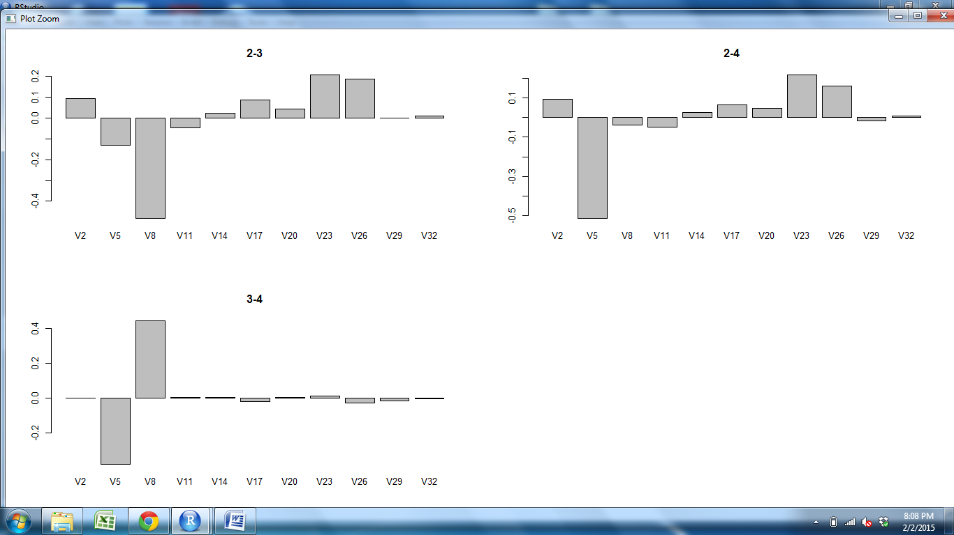
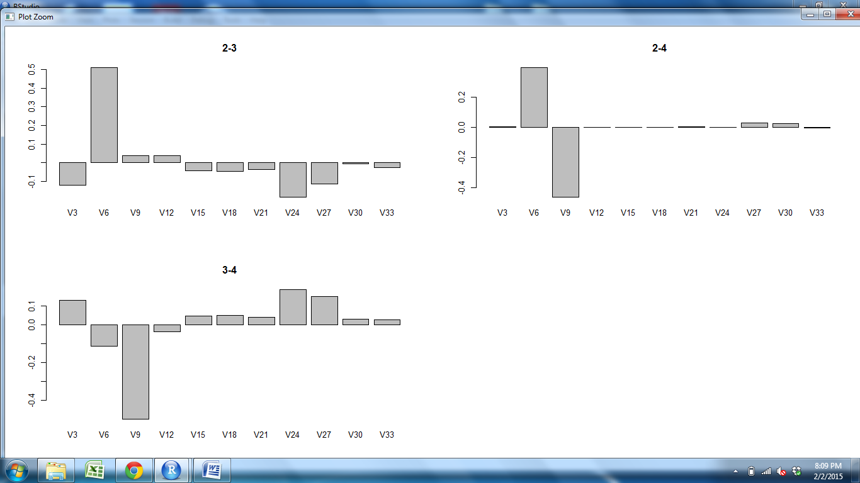
CD11c CD205 CD25 CD31 Claud34 Claud5 Foxp3 K14 K5 PDGFRb UEA1

Slide 6
CD11c CD205 CD25 CD31 Claud34 Claud5 Foxp3 K14 K5 PDGFRb UEA1

Slide 7
CD11c CD205 CD25 CD31 Claud34 Claud5 Foxp3 K14 K5 PDGFRb UEA1

Slide 8
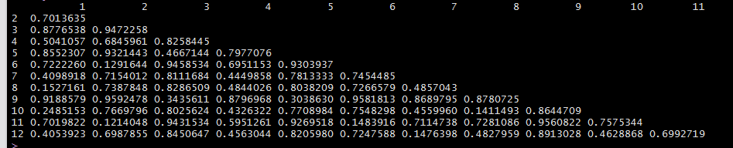
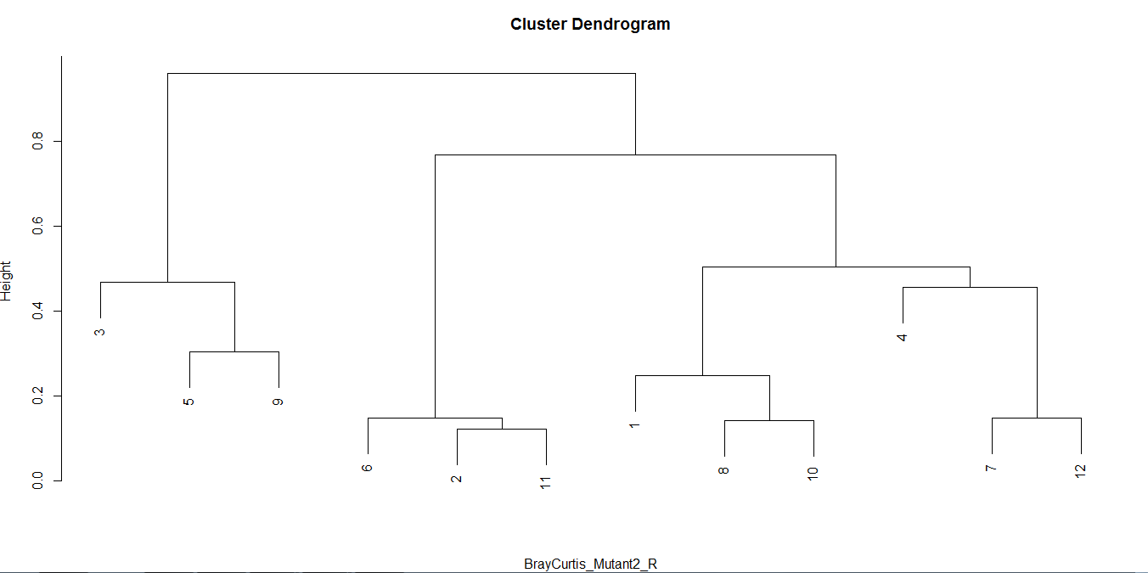
Cortex M Outer Subcap Outer M Subcap Cortex Outer Cortex M
M
Outer
Subcap
Outer
M
Subcap
Cortex
Outer
Cortex
M
Subcap
S1Outer S2Outer S3Outer S2M S1M S3M S1Cortex S2Cortex S3Cortex S1Subcap S2Subcap S3Subcap

